Slide 1
Avoiding being a script kiddie
by ViviTurtle
shamelessly edited by Hansen

Slide 2
Foreword
Learning requires time and effort
Google is your friend
Disclaimer, and ethics

Slide 3
Terminology

Slide 4
Malware

Slide 5
Umbrella term for malicious software

Slide 6
Virus

Slide 7
Malicious code that must be executed by user

Slide 8
Worm

Slide 9
Malicious code that is propagated through a network
Ex: Stuxnet

Slide 10
DDOS

Slide 11
Distributed Denial of Service

Slide 12
Uses a list of servers to attack

Slide 13
Script kiddie

Slide 14
Kid who doesn’t know how things work and only runs premade scripts

Slide 15
Brute force

Slide 16
Systematically and exhaustively checking every key possible

Slide 17
Web Basics

Slide 18
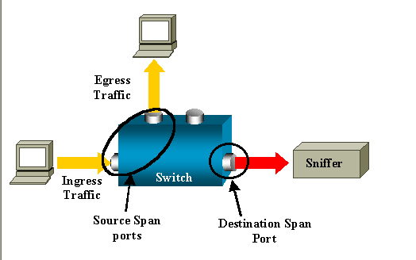
Sniffing
Grabbing info that is otherwise supposed to be private to user
https://itdaddy.files.wordpress.com/2008/05/sniff.png

Slide 19
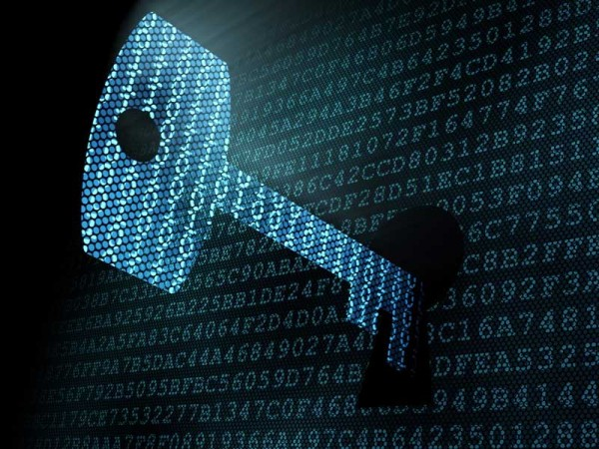
Encryption, Hashing, and Encoding
http://www.ip-watch.org/weblog/wp-content/uploads/2015/06/encryption-image.png

Slide 20
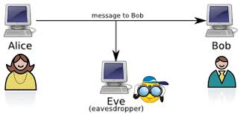
Encryption
Making it so any data cannot be read during its transfer
Can be decrypted because end user knows how
Secure Connections
http://osiriderce.altervista.org/wp-content/uploads/2014/07/aliceBob.jpg

Slide 21
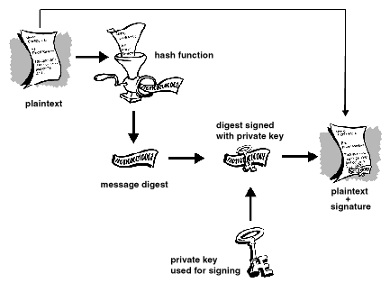
Hashing
“One way encryption”
Cannot be decrypted
MD5, SHA256….
Usages:
Data Validation (Compare hashes)
Storing Personal Data (Like passwords)

Slide 22
Encoding
“Same Data, different look”
“Can send data in readable format”
Different form of data representation

Slide 23
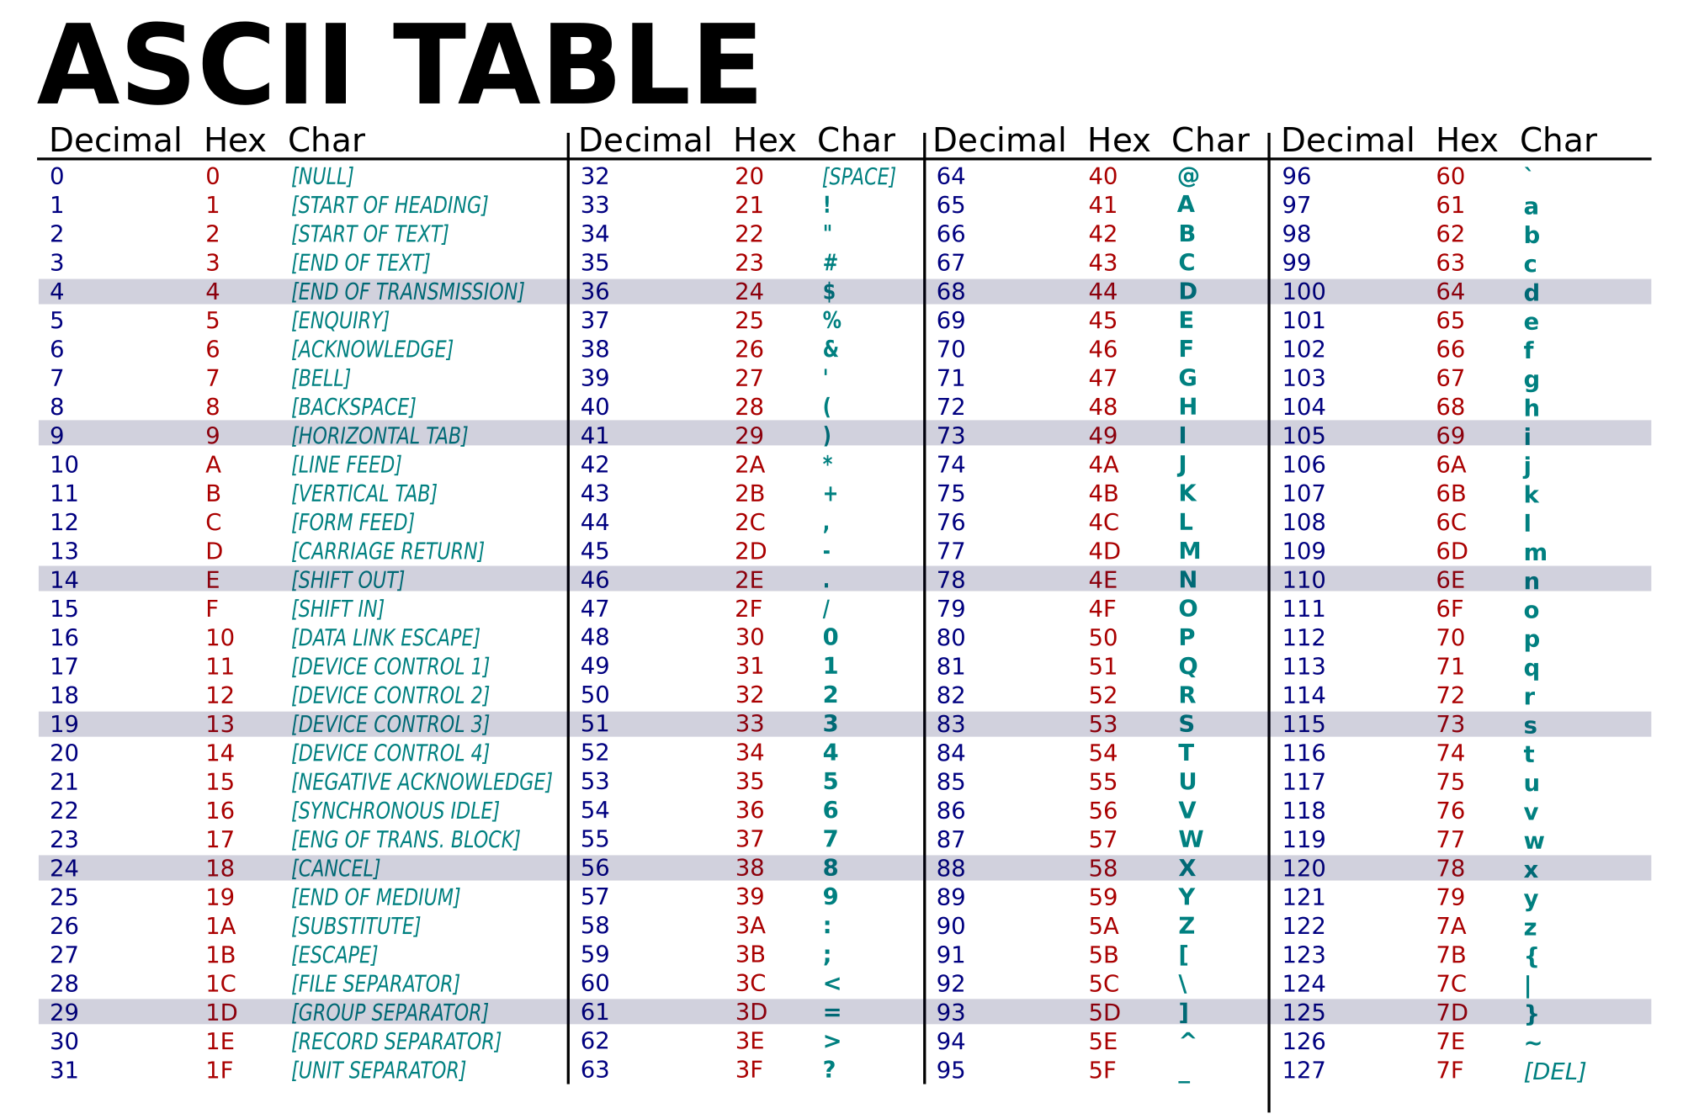
Common Encoding Character Sets
Base64
{A-Z, a-z, 0-9, (+/) }
Hexadecimal
{0-9, A-F}
ASCII
{see table}
Binary
{0,1}
https://upload.wikimedia.org/wikipedia/commons/thumb/1/1b/ASCII-Table-wide.svg/2000px-ASCII-Table-wide.svg.png

Slide 24
Operating Systems and Linux

Slide 25
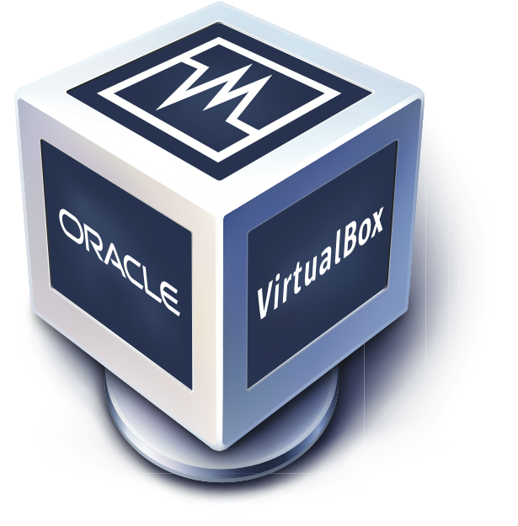
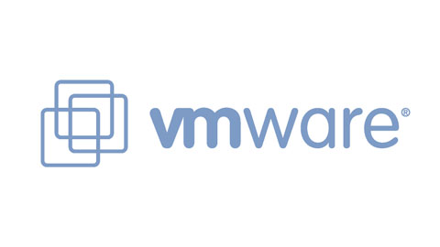
Virtual Machines
Lets you emulate a network and/or Operating System
No extra hardware needed
Expendable software
Utilize software intended for different platforms
http://www.oracle.com/ocom/groups/public/@otn/documents/digitalasset/176619.png
https://www.mirantis.com/wp-content/uploads/2013/02/vmware_view_pilot-5132020.jpg

Slide 26
Operating Systems
Software that manages hardware
Examples are Linux, Windows, and OS X
If you have never reformatted your own computer try install an OS on a VM. You should know how to at the very least set up your own computer if it breaks, or you are just wiping everything and starting fresh

Slide 27

Why Linux
Many tools are in command line (all tools in one place):
msf, md5sum, bash, python, hydra, medusa, sqlmap, …
Many servers are on Linux
Smaller resource and storage footprint
No GUI soaking up dev time
Open source tools commonly on open source platform
Customizable and programmable: easy to develop

Slide 28
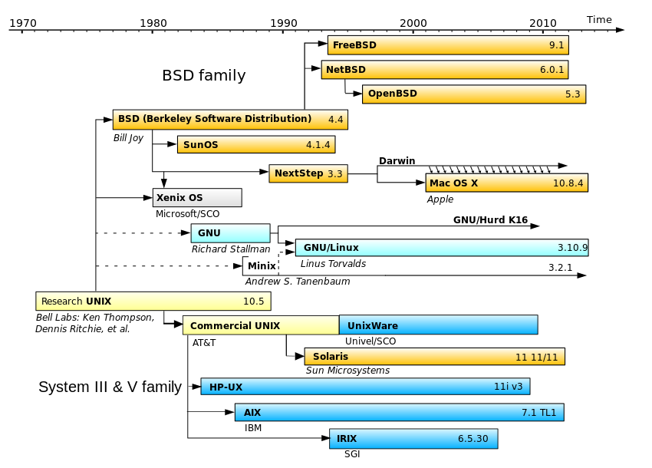
Linux Ecosystem
Unix
BSD
Debian
Ubuntu
Linux Mint
Fedora
RedHat
CentOS

Slide 29
Linux commands
ls:
list files of current directory
cd:
change directory
rm:
remove file
mv:
move files and/or rename
clear:
clear terminal
text editors:
vi, vim, leadpad, emacs, nano
..
previous directory
/
root directory
(what is a directory?)
learn to man
Tools:
ssh, netcat, ftp

Slide 30
Computer Networking

Slide 31
HTTP, HTTPS, FTP, & SSH
HyperText Transfer Protocol
HTTP Secure
File Transfer Protocol
Secure SHell

Slide 32
TCP & UDP
Transport Control Packet
Error-checked delivery
Widely used
User datagram protocol
Faster applications
DNS

Slide 33
Ports
“logical construct that identifies a service or process”
0 through 65535
Software defined
Required start and end point
Example of common ports

Slide 34
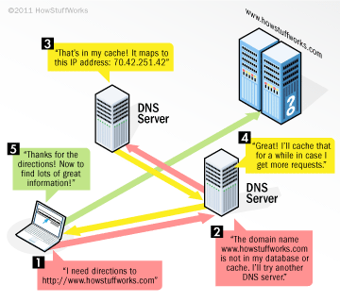
DNS
Domain Name System
“associates various information with domain names”
Tells URLs where to point to
Dynamic vs Static IPs

Slide 35
InfoSec Branches

Slide 36
Cryptography
Secure Encrypting/Decrypting Data
Algorithms
Breaking insecure cryptography
http://www.ip-watch.org/weblog/wp-content/uploads/2015/06/encryption-image.png

Slide 37

Web Application Penetration Testing
Hacking databases
Hacking website users
Breaking the website
http://www.aslitsecurity.com/images/web-penetration-testing.jpg

Slide 38
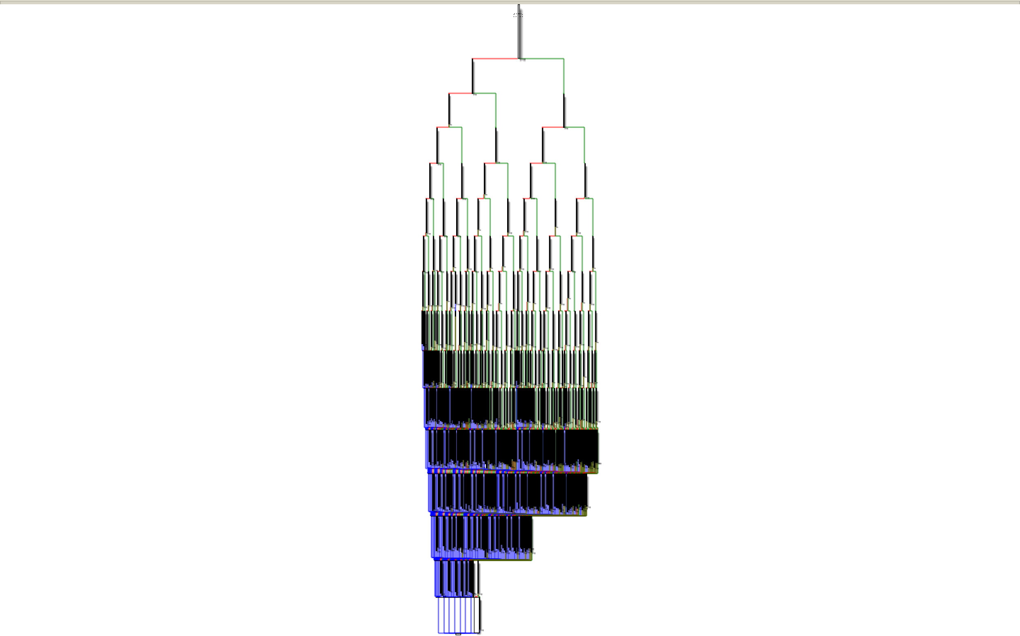
Reverse Engineering
“Going backwards through the development cycle”
Used a lot for malware analysis, binary analysis and vulnerability discovery
Deterred by obfuscation techniques:
anti-disassembly
anti-debugging
packers

Slide 39
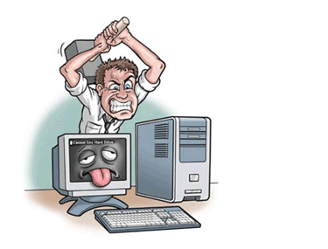
Exploitation
Take advantage of flawed code to perform unintended action
memory corruption vulnerabilities
race conditions
implementation errors
input validation errors
http://www.expressunlimitedpcmac.com/images/computer_hammer.gif

Slide 40
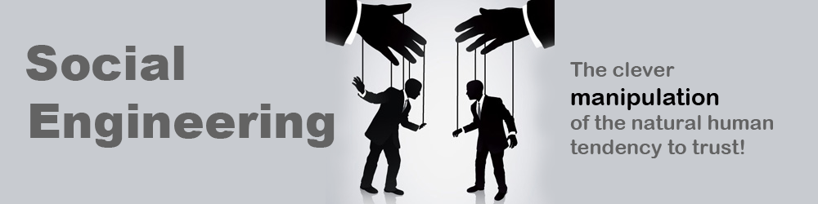
Social Engineering
Get people to do what you want
Hack people
#1 vulnerability in InfoSec is people
Phishing
Lying to people
https://www.cybertec-security.com/wp-content/uploads/2014/11/social-engineering.png

Slide 41
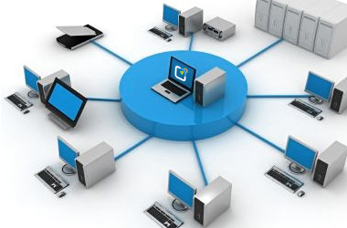
System/Network Administration
Managing the Systems and Networks
Secure practices
Stopping Live Attacks
http://www.it-doctor.co.th/images/computer_network_administration.jpg

Slide 42
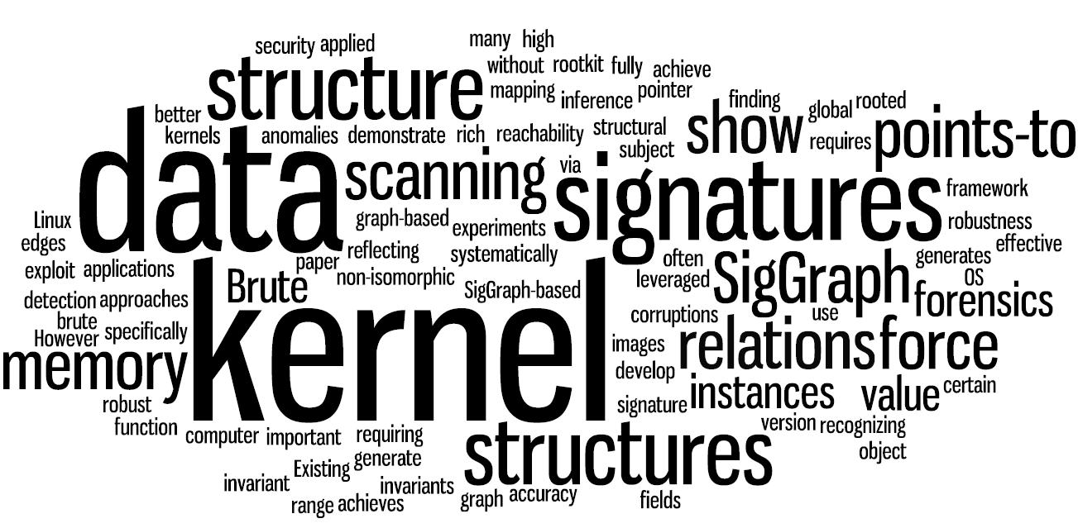
Memory Forensics
Looking at Memory Artifacts
Reverse Engineering for Whole Systems
Who - What- When- How- Why
https://www.utdallas.edu/~zxl111930/img/ndss11.jpg

Slide 43
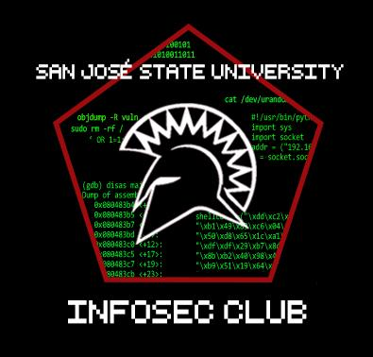
We’ll stop there :)
Questions???
Discuss?
News and zero days

